Slide 1
Path Models
Example 3
Fit Indices

Slide 2
Example
Two models
Let’s make the models
And compare them with their fit indices
Are they nested or not?

Slide 3
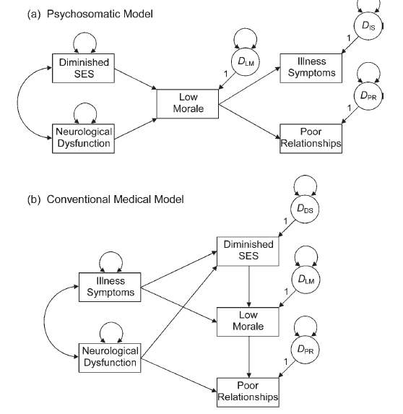

Slide 4
Input the data
Correlation matrix from Kline
data=lav_matrix_lower2full(c(1.00,
.53, 1.00,
.15, .18, 1.00,
.52, .29, -.05, 1.00,
.30, .34, .23, .09, 1.00))
Remember that the 1s indicate it‘s correlation.

Slide 5
Name the data
Use the colnames and rownames function to put names to each column and row.
colnames(data) =
rownames(data) =
c("morale", "illness", "neuro", "relationship", "SES")

Slide 6
Build each model

Slide 7
Run each model
sem(model, sample.cov = data, sample.nobs = number of subjects)
Get some output!
summary(model fit, rsquare = T, fit.measures = T)
This time we are adding fit measures so we can see the fit indices.
You can also use fitmeasures(model fit) to pull them separately.

Slide 8
Compare models
We can compare using the chi-square difference test, because these are nested models.
However, you can’t really go wrong by always using AIC/ECVI.

Slide 9
Fit Indices
Index | Model A | Model B
Chi-square (df) | (4) 40.303 | (3) 3.245
RMSEA | .139 90%CI [ .102, .180 ] | .013 90%CI [ .000, .018 ]
SRMR | .065 | .016
CFI | .905 | .999
TLI | .786 | .998
NFI | .897 | .992
AIC | 6289.813 | 6254.756
ECVI | 0.120 | 0.045

Slide 10
Comparison
Do either of these models appear to be any good?
Which model appears better?
Use pchisq() to determine the if the difference between models is significant.
pchisq(chi square difference, df difference, lower.tail = F)
Want this value to be less than .05 (if you want them to be different).
Can also use the anova() function.

Slide 11
Make Pictures!
semPaths(model fit,
whatLabels="par",
layout="spring")
Don’t forget under whatLabels you can also use “std” for the standardized loadings.

